Slide 1
CMPE 220
Class 19 – Virtual Systems
Notes:
Let’s talk about history.
California State Railroad Museum – 1976 - docents worked on original steam engines.

Slide 2
Virtual Systems
A new(?) kind of system software

Slide 3
Virtual Machines
Abstract the hardware of a single computer system.
Create several different execution environments.
Each environment can have its own operating system.
Each environment believes it has the entire physical system.
Processes
Processes
Processes
Kernel
Kernel
Kernel
VM1
VM2
VM3
Virtual Machine Manager
Host Operating System
Physical Machine

Slide 4
Why VMs?
Allow a user to install and execute software from a different system on their computer
Allow a users to manage a dedicated server on shared hardware
Hosting companies
Cloud environments

Slide 5
Types of Virtual Machine Managers, cont’d
Emulators
Applications written for one hardware environment (one type of CPU) can run on a very different hardware environment (another type of CPU).
Application containment
Not really virtualization, but segregate applications from the host operating system.
Examples: Oracle Solaris Zones, BSD Jails, IBM AIX WPARs

Slide 6
Host vs. Guest Operating Systems
Host (native) operating system
The OS running on the physical machine that supports (among its other tasks) a VMM
Examples:
Linux, Windows, Mac OS X

Slide 7
Host vs. Guest Operating Systems, cont’d
Guest operating system
An OS running in a virtual machine under control of a VMM.
Example:
Debian running under VirtualBox on a Mac
If there is enough physical memory and disk space, it is possible to run several guest OSes (and their applications) simultaneously on a single physical machine.

Slide 8
Virtualization Requirements
Fidelity
A VMM provides an environment for programs that is essentially identical to the original machine.
Performance
Programs running within that environment have only minor performance degradation.
Safety
The VMM is in complete control of system resources required by the guest operating systems.

Slide 9
Brief History of Virtual Machines
1972: Virtual machines first appeared commercially.
IBM VM370 on IBM mainframes.
Late 1990s: Intel 80x86 CPU become popular.
Xen and VMware created VMM technologies for that CPU.

Slide 10
Brief History of Virtual Machines, cont’d
Today: Commercial and open-source VMMs run on all common operating systems.
Example VMM: VirtualBox runs on Intel x86 and AMD64 CPUs on Windows, Linux, Mac OS X, and Solaris.
Example guest OSes: Versions of Windows, Linux, Solaris, BSD, MS-DOS, IBM OS/2

Slide 11
Benefits of Virtual Machines
Backward compatibility
Support earlier OS’s
IBM 360->270
Apple Macintosh
Sharing
Different execution environments can share the same physical hardware resources.
Security
A virus that infects a guest OS is unlikely to affect other guest OSes or the host OS.

Slide 12
Benefits of Virtual Machines, cont’d
Suspend the running of a guest OS.
Create a snapshot the state of a suspended guest OS.
Resume the execution from the snapshot, possibly on different hardware.
Live migration: Move a guest from one physical machine to another without interrupting its operations.

Slide 13
Hypervisors or VMMs
A hypervisor is software that creates and runs virtual machines (VMs).
A hypervisor, sometimes called a virtual machine monitor (VMM), isolates the hypervisor operating system and resources from the virtual machines and enables the creation and management of those VMs.

Slide 14
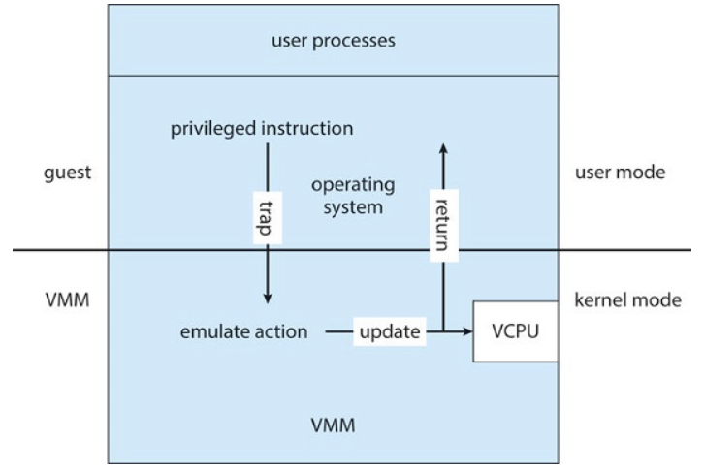
Implementation of Virtual Machines, cont’d
Trap-and-emulate
The guest kernel attempts to execute a privileged instruction, such as to do I/O.
Causes a trap to the VMM in the real machine.
The VMM emulates the privileged operation.
Therefore, privileged instructions create extra overhead.
The guest will run more slowly.
Operating System Concepts, 10th edition
by Abraham Silberschatz, Greg Gagne, and Peter B. Galvin
Wiley, 2018, ISBN 978-1119456339

Slide 15
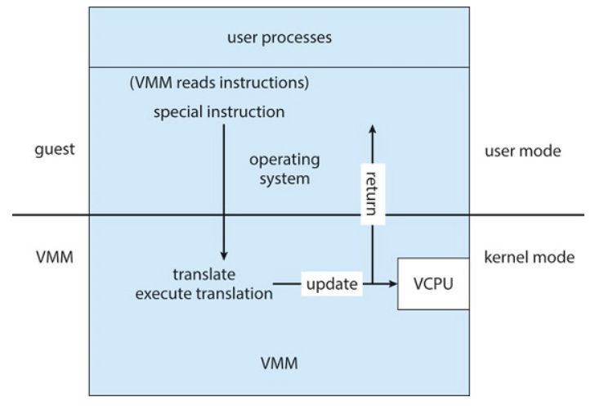
Implementation of Virtual Machines, cont’d
Binary translation
Some x86 instructions (“special instructions”) behave differently in user mode vs. kernel mode.
The VMM translates special instructions in the guest kernel into a new set of native instructions that accomplish the operations.
Operating System Concepts, 10th edition
by Abraham Silberschatz, Greg Gagne, and Peter B. Galvin
Wiley, 2018, ISBN 978-1119456339

Slide 16
Implementation of Virtual Machines, cont’d
Binary translation, cont’d
The new set of instructions can be cached to improve performance.
The VMM must also intercept memory paging requests by the guest kernel.
The VMM maintains nested page tables (NPTs) to map guest paging operations to physical page table operations.

Slide 17
Implementation of Virtual Machines, cont’d
Hardware assistance
Newest CPU chips provide more support for virtualization.
2005: Intel x86 CPU family add VT-x instructions.
Binary translation and NPTs no longer needed.
2006: AMD processors support AMD-V technology.
CPUs with virtualization hardware assistance can automatically deliver an interrupt destined for a guest to a core that is running a thread of the guest.

Slide 18
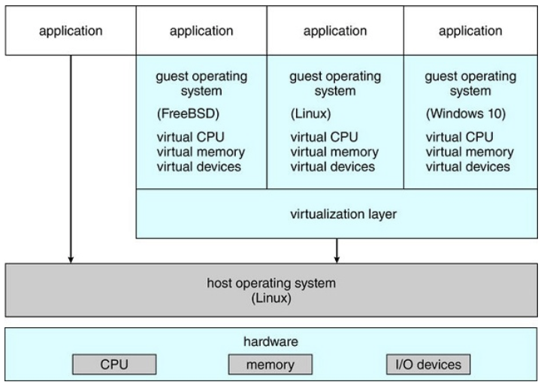
Implementation of Virtual Machines, cont’d
The VMM is just another process running on the host.
Examples: VMware, VirtualBox
The host OS doesn’t know that virtualization is taking place.
Operating System Concepts, 10th edition
by Abraham Silberschatz, Greg Gagne, and Peter B. Galvin
Wiley, 2018, ISBN 978-1119456339

Slide 19
VMM Examples
Vmware
VirtualBox
Parallels
QEMU
Citrix Hypervisor
Microsoft Hyper-V

Slide 20
Implementation of Virtual Machines, cont’d
The VMM may run as a user application.
It might not have the administrative privileges to access the hardware assistance features of modern CPUs.
No changes are required to the host operating system.
Anyone can run VirtualBox to experiment and learn from different guest operating systems.

Slide 21
Virtualization Components
CPU scheduling
There may be more virtual CPUs than physical CPUs.
The VMM must share the available physical CPUs among the guests.

Slide 22
Virtualization Components, cont’d
Memory management
The VMM may overcommit memory among the guests.
The VMM determines how much real memory each guest can use.
Each guest has the illusion that it has all the memory it wants.
The VMM does its own memory page allocation.
It works with the host system’s memory management.

Slide 23
Virtualization Components, cont’d
I/O management
The VMM can dedicate physical I/O devices to guests.
Example: Assign a physical CD ROM drive to a guest.
The VMM can provide idealized device drivers to guests.
The VMM maps guest I/O requests to a device to the actual device driver.

Slide 24
Virtualization Components, cont’d
Storage management
The VMM ensures that each guest can only access the disk blocks allocated to it.
Networking
The VMM provides each guest with at least one IP address.
The VMM provides routing between the guest and the network.
The VMM provides network address translation (NAT).

